Slide 1
Optimizing SharePoint 2007 Performance
Module 10

Slide 2
Capacity Planning
The art of evaluating a technology against the needs of an organization,
and making an educated decision
about the procurement of HW to meet the demands specific to a system being installed

Slide 3
A 4 step program
1: Plan for Software Boundaries
2: Estimate Performance and Capacity Requirements
3: Plan Hardware and Storage Requirements
4: Test

Slide 4
Software boundaries
Two types of limits
Recommend limits (performance)
Hard limits (built in maximums)
Notes:
Sources
Microsoft - http://technet2.microsoft.com/Office/en-us/library/6a13cd9f-4b44-40d6-85aa-c70a8e5c34fe1033.mspx?mfr=true
HP Paper - http://www.hp.com/solutions/activeanswers/sharepoint
Intel Paper - http://technet2.microsoft.com/windowsserver/WSS/en/library/75e692ce-4bba-46c3-951d-e1d9325329821033.mspx?mfr=true
Working with large lists - http://go.microsoft.com/fwlink/?LinkId=95450&clcid=0x409

Slide 5
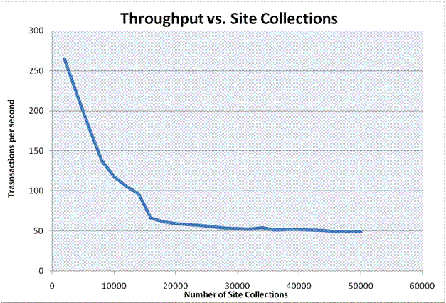
# of Site Collections

Slide 6
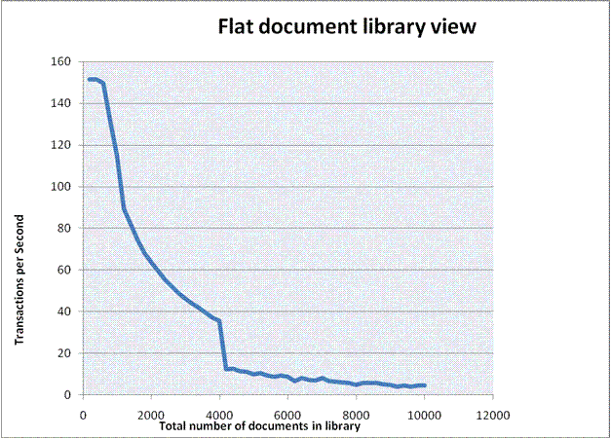
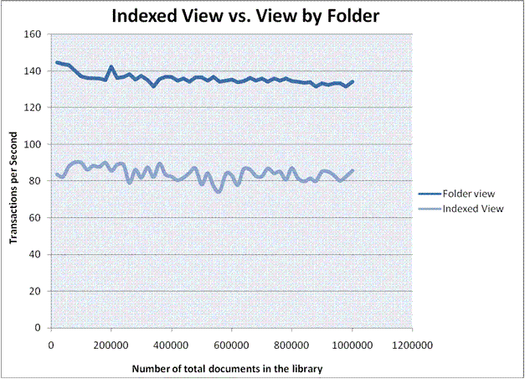
Document Libraries

Slide 7
More Software Boundaries
Site Collections | 50,000 per DB
Site Collections | 50,000 per Web App
Content DBs | 100 per web app
Web Sites | 250k per Site Collection | Use nesting
Sub Sites | 2,000 per site | Very hardware dependent
Documents | 5 million per library | Use nesting
Security objects | 2,000 per site | Groups or users
Indexes | 1 per SSP | 20 SSPs per farm (Hard)
Indexed Docs | 50 Million per index | Buy Hardware
SSPs | 3 recommend | 20 Hard Limit
App Pools | 8 per server
WFEs | 3 per Domain Controller
Remember Everything is Hardware Dependent!
Notes:
Microsoft - http://technet2.microsoft.com/Office/en-us/library/6a13cd9f-4b44-40d6-85aa-c70a8e5c34fe1033.mspx?mfr=true

Slide 8
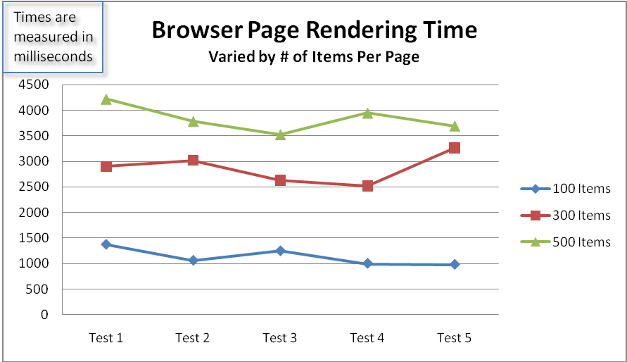
Items displayed on page matters

Slide 9
Step 2: Estimate performance and capacity
Usage Profiles
Target performance levels

Slide 10
Usage Profiles
Common profiles
Collaboration (Read/Write)
Portals (Everything)
Search (Search Server)
Business Intelligence (Calculations)
Internet (Read)
Authentication vs. Anonymous

Slide 11
Determine usage profiles
Existing solution? Data mining
IIS Log Parses 2.2
Microsoft provides sample data
Notes:
TechNet - http://technet2.microsoft.com/Office/en-us/library/054526b9-417e-4140-b251-79b68e771c9a1033.mspx?mfr=true

Slide 12
Target Performance
Plan RPS for peak load not average
Example
MSFT 1 farm average = 10 RPS Peak = 130 RPS
Be careful what you read
Lots of # on the web but all have assumptions behind them

Slide 13
Demo!
Take a closer look at Microsoft’s Papers
Estimate performance and capacity requirements for Windows SharePoint Services collaboration environments (Office SharePoint Server)
Notes:
http://technet2.microsoft.com/Office/en-us/library/0a7b2b45-f633-46d2-a4fd-78691d4b8f631033.mspx?mfr=true

Slide 14
Other performance factors
Long running lock operations
Backups
Indexing
Additions/Customizations
Page size
SQL Round trips (bad code)
Permissions
Security trimming
Cache?
MOSS brings huge performance increases

Slide 15
Output Cache
Uses configurable profiles
Keeps page from executing code
Lowers CPU load
Stores page in memory
Consumes more RAM
Multiple WFEs can cause varied results
Use persistence/affinity/sticky sessions
.NET 2.0 Technology
Set at collection/page/layout
Notes:
http://msdn2.microsoft.com/en-us/library/aa661294.aspx

Slide 16
Object Cache
Caches
Page items
Cross list queries (CQWP)
Configurable for site collection
Used except when document is checked out
Notes:
http://msdn2.microsoft.com/en-us/library/aa622758.aspx

Slide 17
BLOB Caching
Controlled via web.config
Stores normally static files on disk
No more trips to the DB
Disabled by default
maxSize in GB
Max-age can be added in seconds
Notes:
http://msdn2.microsoft.com/en-us/library/aa604896.aspx

Slide 18
Demo!
Setting MOSS to use Cache

Slide 19
Step 3: Hardware and Storage
Servers
Tuning
Storage planning

Slide 20
32 bit vs. 64 bit
Both supported and available
32 bit is generally faster
Farm - Same role, same architecture
New hardware?
Buy 64 bit hardware
Load 32 bit OS and SharePoint
V.next will only be 64 bit
Use 64 bit if needed to support > 4GB of RAM
Some 3rd parties do not support 64bit

Slide 21
Servers
Network bandwidth is huge
Gigabit or vlan for farms
Misconfigured network
Geo solutions location important
Farm cannot be spread across WAN
Options
Local SharePoint
3rd party accelerators
3rd party replication
SLAs
Understanding end to end usage

Slide 22
SQL Planning
Database Storage 1.5:1 against file system
Disk performance most important
Plan DB needs sizing
Don’t forget about backups

Slide 23
Understand IIS
Choose # of App Pools carefully
Each one consumes resources
Find balance
IIS does compression
SharePoint automatically adds JS and CSS files
Web gardens help scale
Watch out for IIS logs on C: drive

Slide 24
Demo!
Fun with IIS tuning

Slide 25
Random Tip
Adjust server upload
50 MB default upload max – configure central admin
Modify IIS property connection timeout (120 default)
Modify web.config
change C:\Program Files\Common Files\Microsoft Shared\web server extensions\12\TEMPLATE\LAYOUTS\web.config
<location path="upload.aspx"> <system.web> <httpRuntime maxRequestLength="2097151" /> </system.web> </location>
ADD executionTimeout="999999"

Slide 26
Are you a fiddler?
http://www.fiddlertool.com/fiddler/
Web Debugging Proxy
Translation –
Lets you see the raw traffic between browser and server. Great for running down strange behavior.

Slide 27
Tune Performance from Microsoft
http://technet.microsoft.com/en-us/library/cc298550.aspx

